Slide 1
Course 5
Maintainability, Reliability

Slide 2
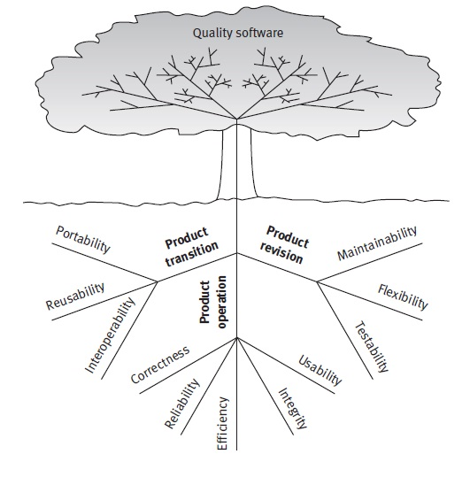

Slide 3
Maintainability [McCall]
Definition: Effort required to locate and fix an error in an operational program
Impact:
Measured: design + implementation
Realized in: maintenance + transition

Slide 4
Maintainability
Consistency
Simplicity
Conciseness
Modularity
Self-descriptiveness
McCall
uniform design & impl. tech. & notations
also in correctness + reliability
avoid increased complexity
also in reliability & testability
minimum amount of code
structure of indep. modules
Also in flexibility, testability, portability, reusability & interoper.
explanations
Also in flexibility, testability, portability & reusability

Slide 5
Maintainability measured …
Maintainability index
MI = 171-5.2 x ln(aveV)
-0.23 x aveV(g’)
16.2 x ln(aveLOC)
+ 50 x sin sqrt(2.4 PerCM)
http://www.virtualmachinery.com/sidebar4.htm
[-100, 200]
MI = MAX(0,(171 - 5.2 * ln(Halstead Volume) –
0.23 * (Cyclomatic Complexity) –
16.2 * ln(Lines of Code))*100 / 171)
[0,100]
0-9 =bad; 10-19= satisfactory; 20-100 = acceptable

Slide 6
Halstead complexity: V = N x log2(n) N = no of operators n = no of distinct operators
Parameter | Name | Measures
aveV | Average Halstead complexity | Computational density
aveV (g') | Average extended cyclomatic complexity | Logical complexity
aveLOC | Average count of lines of code | Code size
PerCM | Average percent of lines of comments | Human insight
Cyclomatic complexity: = number of linearly independent paths through a program
Notes:
Cyclomatic complexity- establishes the maximum number of test cases required to ensure that each program's statement is executed at least once

Slide 7
Maintainability influenced by…
Analyzability
Changeability
Stability – encapsulation and data hiding
Testing
Development environment features
Locate causes of failure correct
Locate parts for modification – extend
Readability
Comprehensibility
Traceability
Easily identify elements to change
Changes compared to the specification
Changes affect rest of the system
Analysis: browsing & searching
Build: automated
Testing
Commit: privileges
Advice:
style: name convention, indent
simple !!!
comments
Unit testing
Integration testing
System testing
Test coverage

Slide 8
Dependencies & coupling
Data coupling
Stamp coupling:
Large data structure is passed, and only a part is required
Control coupling
Common coupling – global variables
External coupling: diff. modules sharing common resources
Content coupling: module modifies or relies on another module
Homework:
Example & impact on maintainability
+ use a tool to see progress

Slide 9
Maintainability measured …
3 purposes:
System maintainability over time – disintegrate as it evolves
Compare different systems performing the same task
Evaluate parts – less maintainable – target for refactoring

Slide 10
Maintainability measured …
Tools:
Lachesis Eclipse plug-in
http://lachesis.sourceforge.net/
JetBrains's IntelliJ MetricsReloaded plug-in
http://www.jetbrains.com/idea/
- Metrics – .NET framework

Slide 11
Maintainability for OOP
WMC – Weighted Methods per Class
DIT – Depth of Inheritance Tree
NOC – Number of Children
CBO – coupling between objects (method call, field access, inheritance, exceptions, …)
…
Notes:
WMC = sum of methods weighted by complexity; if complex difficult to maintain
DIT = for each class no of levels from top; big value – difficult to maintain
NOC – high
1. fundamental class
2. subclassing misuse
3. indicate reuse through inheritance

Slide 12
Reliability

Slide 13
Reliability
Definition
in engineering: the ability of a product or component to continue to perform its intended role over a period of time to pre-defined conditions
software systems: is measured in terms of the mean time between failures, the mean time to repair, the mean time to recover, the probability of failure and the general availability of the system.
Aspects:
Maturity – absence of software faults that lead to failures
Robustness (Fault tolerance) – performance to specification despite some faults
Recoverability – operation after a failure

Slide 14
Reliability issues
Input problems
Output problems
Logic problems
Computation problems
Data-handling problems
Fault tolerance

Slide 15
Input problems
DON’T accept wrong input (out-of range values)
Accept all possible correct input
Reject unreasonable input – careful
Consider missing input elements

Slide 16
Output problems
Adding an element to a program and forgetting to update output routines
Incomplete or missing output
Correct results at the wrong time
Wrong format
Sensitive to time, especially for files, printer, …
Internal representation vs. human readable representation
special output displays

Slide 17
Logic problems
Associated with program’s control flow
Affect operations and data
Difficult to detect and locate
Typical:
Off-by-one errors
Neglecting extreme conditions
Forgotten cases, condition tests or steps
Misinterpretation of specification
- Missing processing or counting the first or last element of a range
Values outside range
Notes:
Forgotten – statement switch or case – forget a case
Misinterpretation – specificatio in natural language

Slide 18
Computation problems
Incorrect algorithm or computation
Example 1:
Evaluate an expression using Polish Postfix Form
Input: 7-4-3; output: 6
Example 2:
Evaluate a or b and c
Uninitialized variables
Referencing NULL
Abusing type system

Slide 19
Data-handling problems
Incorrect data initialization
Referencing wrong data variable
Out-of-bounds values
Inconsistent data – representation – add, update, delete

Slide 20
Fault tolerance
Fault = software or hardware problem in a component of a system under examination
Fault – leads to a system failure: behavior deviated from specification requirement
Fault-tolerance system:
detect and diagnose the fault
report/ mask/ compensate it
=> Avoid failure

Slide 22
Reliability McCall model
Definition: extend to which a program can be expected to perform its intended function with required precision
Includes:
Availability
Accuracy
Robustness
Precision
Tolerance

Slide 23
Key factor in applications:
Human lives affected
Very high system development cost
Real-time

Slide 24
Criteria
Error tolerance
Consistency
Accuracy
Simplicity

Slide 25
Measured in:
Analysis
Design
Implementation & debugging
Impact on:
Testing
Operation (execution)
Maintenance

Slide 26
Evaluation (see McCall.pdf)
Based on criteria:
Consistency: procedure + data consistency
Accuracy
Error tolerance: error tolerance, input data, recoverable computational failures, recoverable hardware faults, device status condition
Simplicity: design structure, programming paradigm (structured), data and control flow complexity, code simplicity

Slide 27
Tools for Reliability Evaluation
Isograph – Reliability Workbench: Fault Tree Analysis, Reliability Block Diagram Analysis, Event Tree Analysis, Markov Analysis a.s.o.
Item – ToolKit prediction and analysis suite: Markov module, FaultTree, ARALIA
Relex – Relex prediction and analysis suite: 17 module for reliability prediction, data analysis a.s.o.
Notes:
Fault Tree analysis – identifies and ranks combinations of events that can lead to system failure
Markov analysis – calculates reliability based on simulation
ARALIA – quick decision processing, based on statistical distribution of failure probabilities, computes exact measure of event importance,…

Slide 28
Explanation of terms
Fault Tree Analysis – identifies and ranks combinations of events that can lead to system failure
Markov analysis – calculates reliability based on simulation
ARALIA – quick decision processing, based on statistical distribution of failure probabilities, computes exact measure of event importance,…

Slide 29
Fault Tree Analysis (FTA)
deductive failure analysis based on Boolean logic
1962 – Bell Laboratories – aviation
Used in reliability and safety analysis
Used in SE – debugging
Deductive ⇒ backwardly deduce the causes of the event

Slide 30
Fault Tree Analysis (FTA)
Analyze an undesired state of the system – combine series of lower-level events:
Defined undesired event
The event is resolved into its immediate causes
This resolution of events continues until basic causes are identified
A logical diagram called a fault tree is constructed showing the logical event relationships

Slide 31
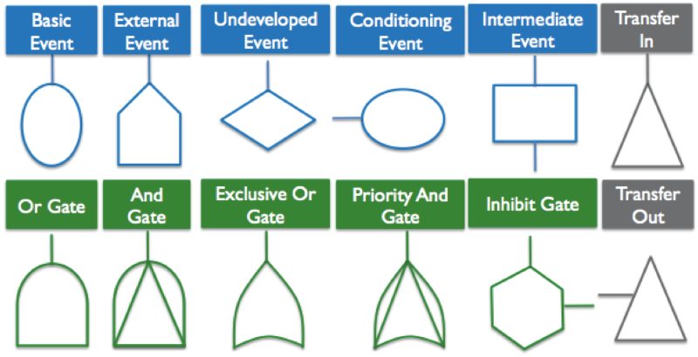
Fault Tree Analysis (FTA)
Graphical symbols:
Event
Gate
Transfer

Slide 32
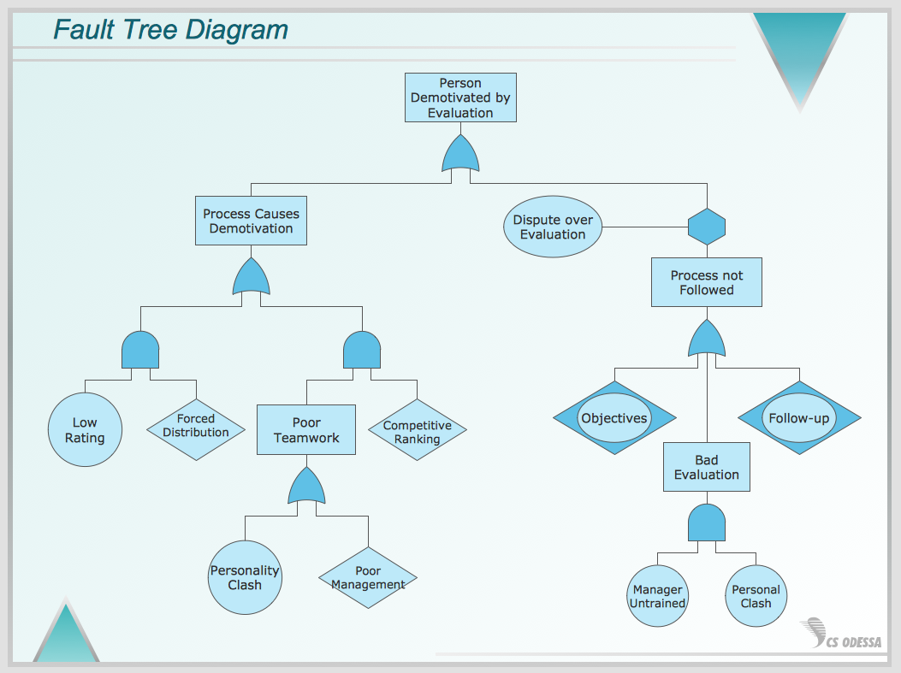
FTA- example

Slide 33
try
http://www.fault-tree-analysis-software.com
Notes:
https://www.smartdraw.com/fault-tree/
https://www.fault-tree-analysis-software.com/fault-tree-analysis?type=Railway

